Slide 1
Holy Habit 1. Biblical teaching

Slide 2
Call to worship Hymn RS 319 Thanks to God whose word was spoken opening prayers AND Lords Prayer Introduction of ‘Holy Habits’

Slide 4
1. Biblical teaching 6. Service
2. Fellowship 7. Eating together
3. Breaking of bread 8. Gladness and generosity
4. Prayer 9. Worship
5. Giving 10. Making more disciples

Slide 6
Biblical teaching the first holy habit is mentioned in Acts 2 Preaching learning Together

Slide 7
Hymn no one can tell what life will bring offertory a song to welcome the word reading Acts 2 :37-47 First ‘holy habit’ Biblical teaching

Slide 8
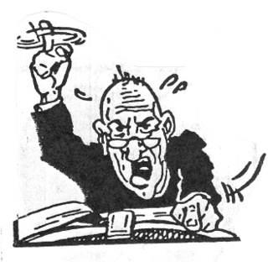
how do we attain biblical teaching? Biblical teaching … Preaching Spirit filled Biblically based Christ centred

Slide 9
Biblical teaching … Learning together 1. learning is … social 2. Learning is ... people take responsibility for their own learning 3. Learning is … mainly informal and life related 4. LEARNING IS … SHARED and accessible

Slide 10
5. LEARNING IS … LEARNING FROM EACH OTHER 6. LEARNING Is … mISSION ‘focus’ disciples must go our from the community to be involved in service and then return to reflect (Theological reflection)

Slide 11
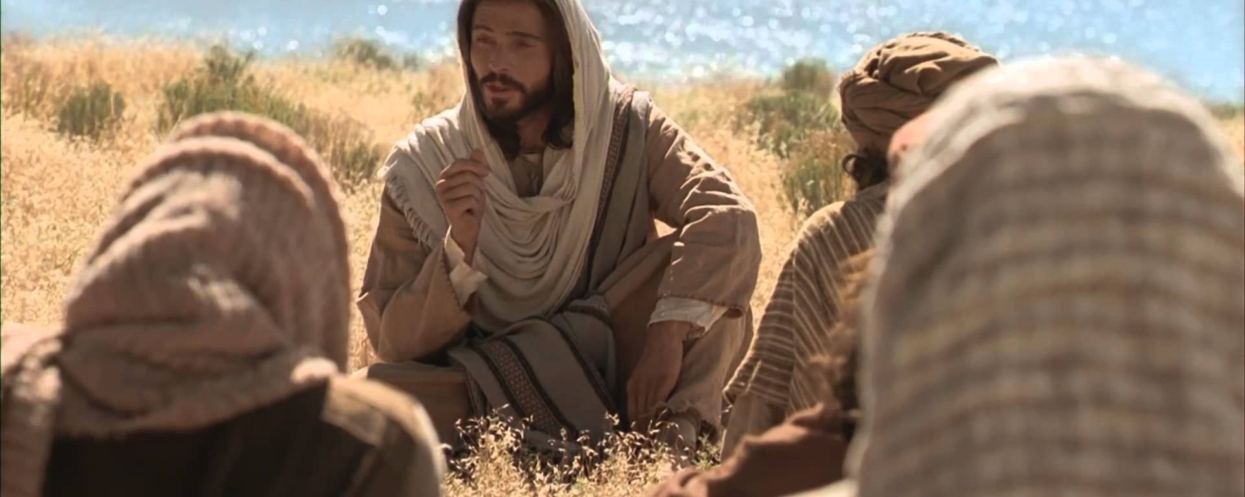
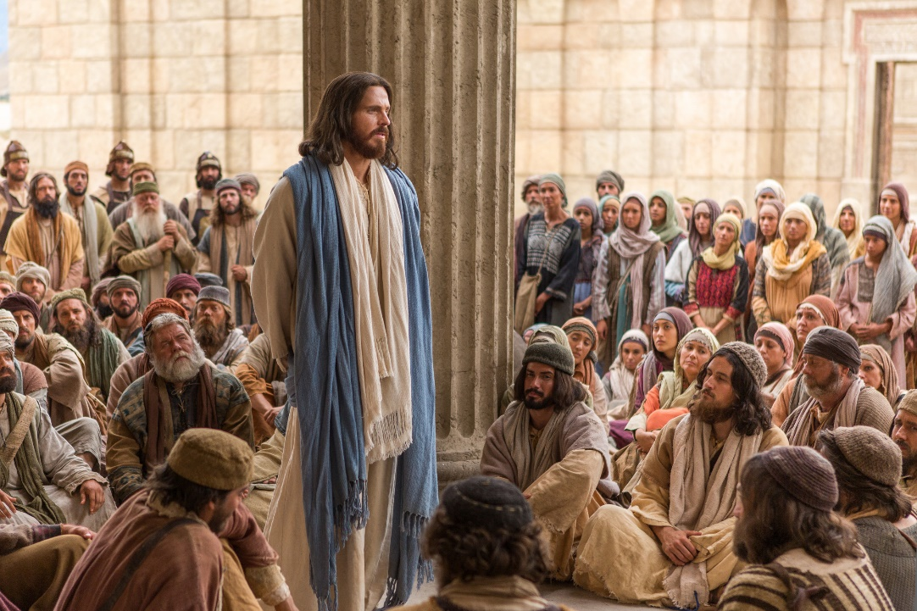
Jesus gave sermons and addressed the crowds, however he also encouraged discussions and gathered people in smaller groups

Slide 12
Why do Biblical Teaching ? 1. Biblical teaching helps us draw near to God 2. we are all part of the gospel story , inspired from the past, to be active in the present. 3. We learn how to be ‘spirt filled’ disciples of Christ.

Slide 13
Personal action after Biblical teaching 1. O.r.i.d. Observe, reflect, Interpret, decision 2. Local church community 3. Global issues to be addressed

Slide 14
2 Timothy 3 : 16-17 ‘All scripture is inspired by God and is useful for teaching, for reproof, for correction, and for training in righteousness, so that everyone who belongs to God may be proficient, equipped for every good work’. 1. What do you notice in this passage ? 2. What will you do or change in the light of what you have read and noticed ?

Slide 15
Hymn though we had thought you must provide prayers of intercession Hymn RS 509 O jesus I have promised Closing prayer and blessing

