Slide 1
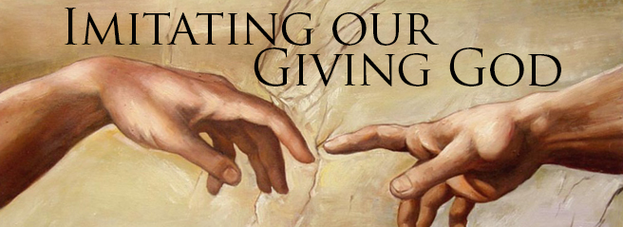
Theme – Holy Habits 5. Giving

Slide 2
Call to worship words from psalm 68:32-35 Leader We lay aside our busyness, and pray for rest. All We lay aside our distractedness, and pray for peace. Leader We lay aside our dissatisfaction, and pray for gratitude.

Slide 3
All We lay aside our fear,
and pray for courage.
Leader We lay aside our divisions,
and pray for unity.
All We lay aside all that separates us from you, and pray for your blessing. Amen.

Slide 4
Hymn rs 586 All my hope on God is founded opening prayers and the Lords Prayer a song of welcome for the word Reading Acts 3:37-47 2 Corinthians 9

Slide 5
1. Biblical teaching 6. Service
2. Fellowship 7. Eating together
3. Breaking of bread 8. Gladness and generosity
4. Prayer 9. Worship
5. Giving 10. Making more disciples

Slide 6
Giving

Slide 7
Early Christians - Early Christians following on from the Essenes in Qumran - used to pool their resources of sharing and selling possessions to create a common fund which could support those in need - maintained sources of income and businesses

Slide 8
Key Points of Giving 1. The nature of God 2. Giving is the key part of God’s nature and it is possible to read the Bible as a story of giving 3. Even when God’s gift is rejected, God keeps On giving

Slide 9
The Holy Habit of Giving starts with Locating that thinking within the generous, extravagant even persistent nature of God

Slide 10
Models of Giving 1. economic Tithes (continuation of Jewish custom) offerings (widow’s mite) 2. Love linked to other holy habits, service, time, thirst for knowledge, prayer

Slide 11
Hymn rs 42 For the fruits of all creation offertory Hymn RS 145 O little town of Bethlehem Forms of Giving …

Slide 12
Gift …. of time gift ……of love Gift ………… of yourself Gift …………… of hospitality Gift ……… of prayer Gift …. of joy Gift ………… of presence Gift ……… of Giving

Slide 13
Transforming Challenge is the most challenging because it challenges most directly the selfishness that is at the heart of many powerful economic systems, which are the root of personal sinfulness.

Slide 15
Hymn Great source of all our life Prayers of intercession

Slide 16
Tears in Heaven

Slide 17
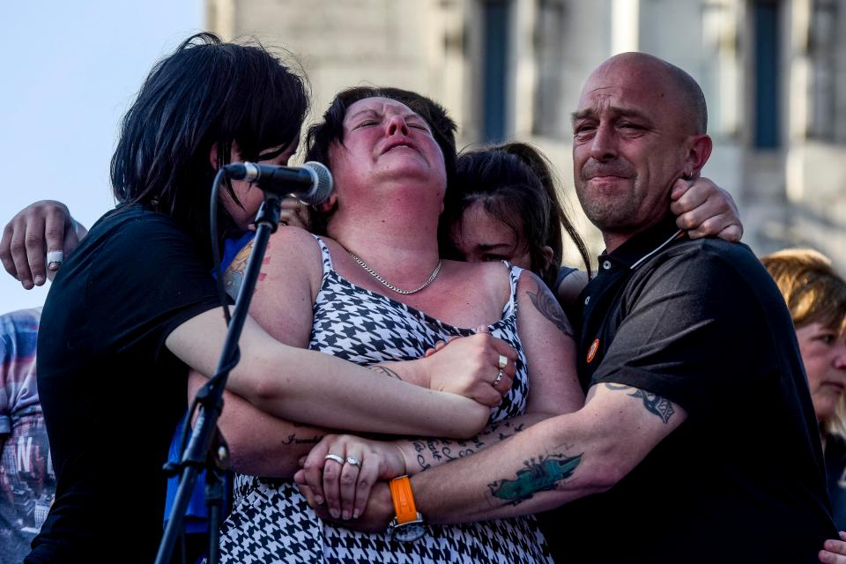

Slide 18
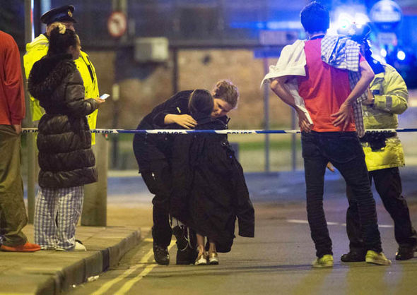

Slide 21
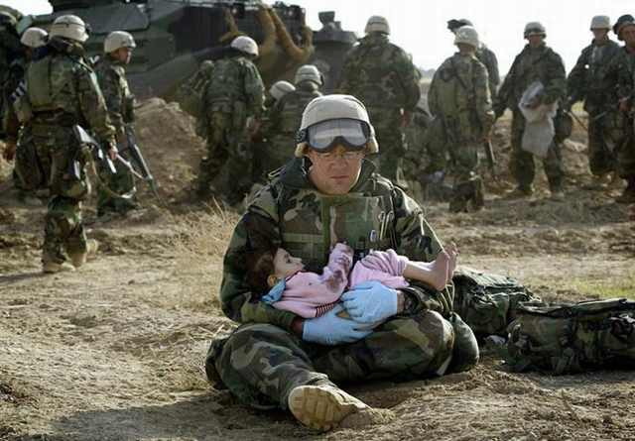

Slide 23
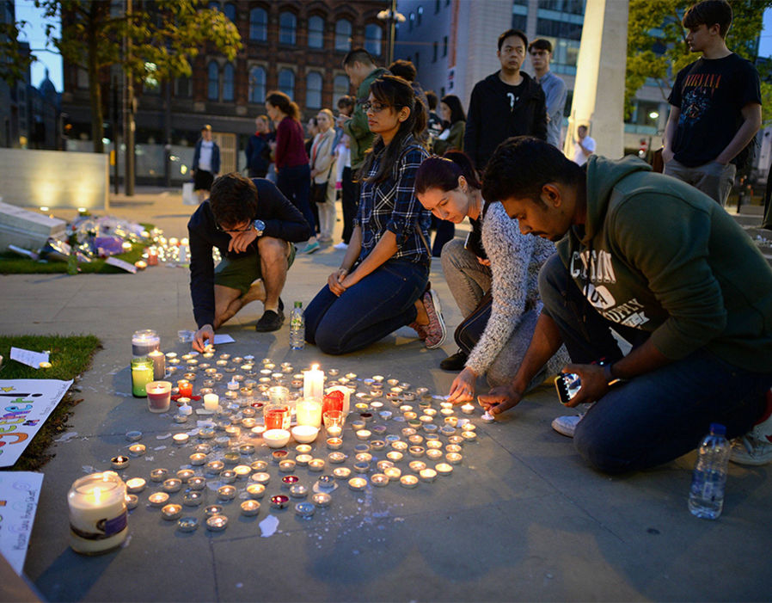

Slide 25
Hymn RS 72 Now thank we all our God Closing prayer and blessing

