Slide 1
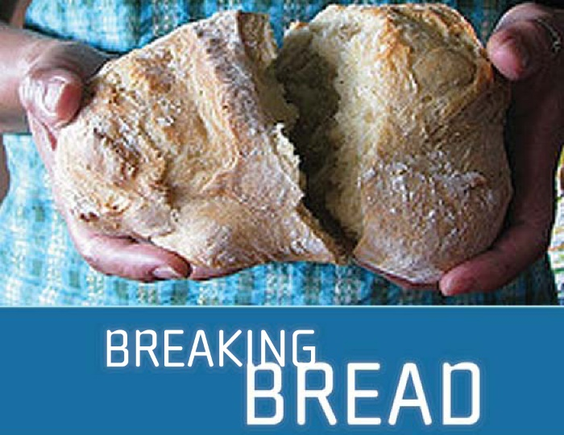
Theme – Holy Habits 3. Breaking of Bread

Slide 2
Call to worship Come and worship, come and worship Praise our God, Praise our God Let us join and sing, Let us join and sing God is Love, God is Love ©Ruth Dillon 2017 Tune Freres Jacques Hymn What shall our greeting be ? opening prayers and the Lords Prayer Reading acts 2 :37-47

Slide 3
1. Biblical teaching 6. Service
2. Fellowship 7. Eating together
3. Breaking of bread 8. Gladness and generosity
4. Prayer 9. Worship
5. Giving 10. Making more disciples

Slide 4
‘Breaking of bread’ Question WHAT COMES TO Mind?

Slide 5
- Holy communion - Eucharist - The lords supper - the love feast - Agape meal Fellowship/ Koinonia

Slide 6
Mother church children, especially daughters who were in domestic service had a day off a year to visit their mothers and family and renew relationships. on the way flowers would have been gathered in the hedgerows to give to the parents.

Slide 7
Mothering Sunday 1. relates to returning to the mother ‘church’, where they felt nurtured, a sense of belonging and ’re-membered’. 2. today, on mothering Sunday we remember memories, some sad and happy, which reflects the life of jesus and the challenges of nurturing today.

Slide 8
Hymn Fathers and mothers…. offertory a song to welcome the word reading 1 Corinthians 11:23-26 third holy habit … Breaking bread

Slide 9
^{In breaking bread} ⁴²They devoted themselves to the apostles’ teaching and fellowship, to the breaking of bread and the prayers. ⁴⁶Day by day, as they spent much time together in the temple, they broke bread at home

Slide 10
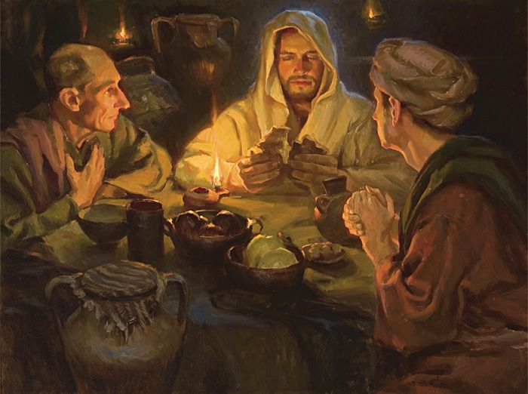
Luke’s understanding 1. Meal began in an everyday context 2. road to Emmaus 3. Anytime, anyplace and anywhere 4. Linked to thanksgiving

Slide 11
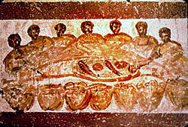
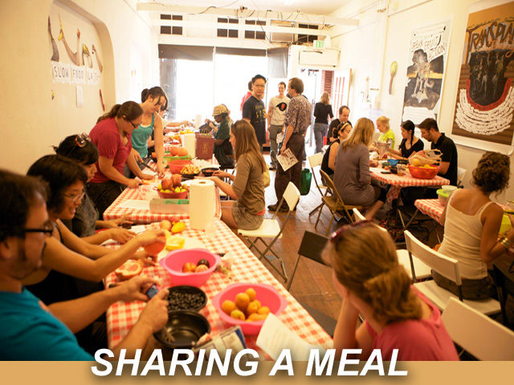
We ‘break bread’ in many places at church on a park bench in the playground in a home in a café in prison beside hospital beds …………………

Slide 12
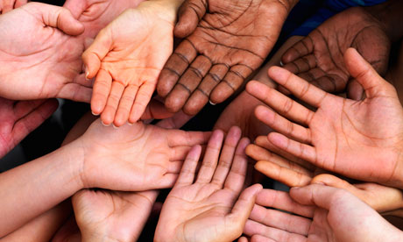
Hands 1. when we stretch out hands to receive the bread and wine we are all the same – sinners are transformed by grace 2. Different Hands with arthritis, smooth skinned hands of children the hands of those I find easy to love and the hands of those I feel challenged to love. 3. black hands, white hands, eager hands, hesitant hands troubled hands, shaking hands, yet all are open hands

Slide 13
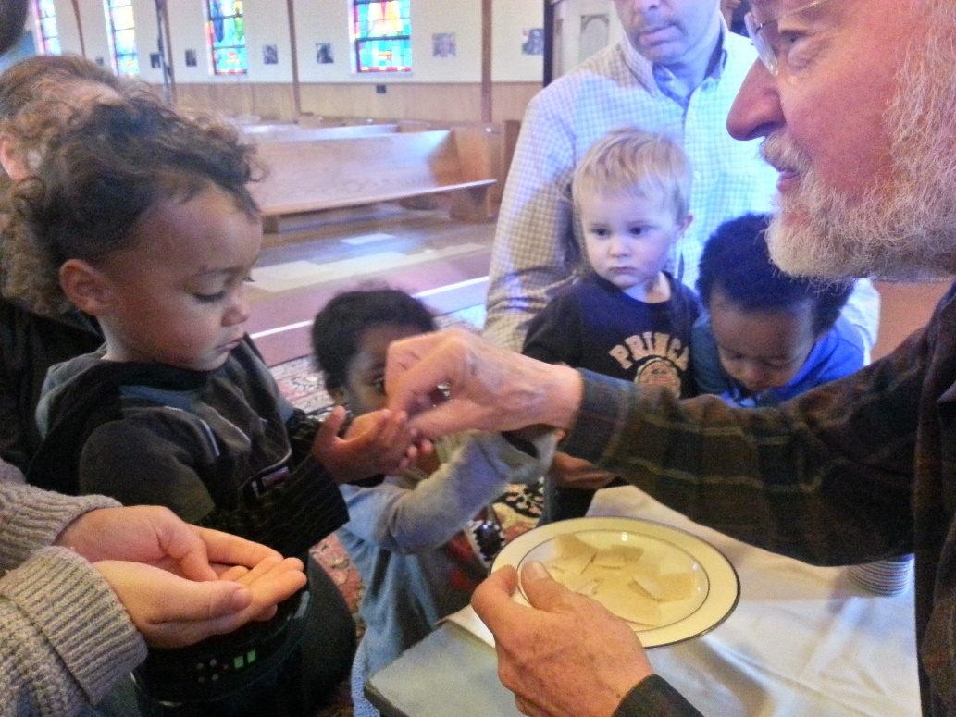
Gift to share for all people 1. the Open table, A sign of a inclusive community 2. a symbolic sign of selfishness being overcome by grace 3. An awareness that the shared gift needs to be adapted to include all people

Slide 14
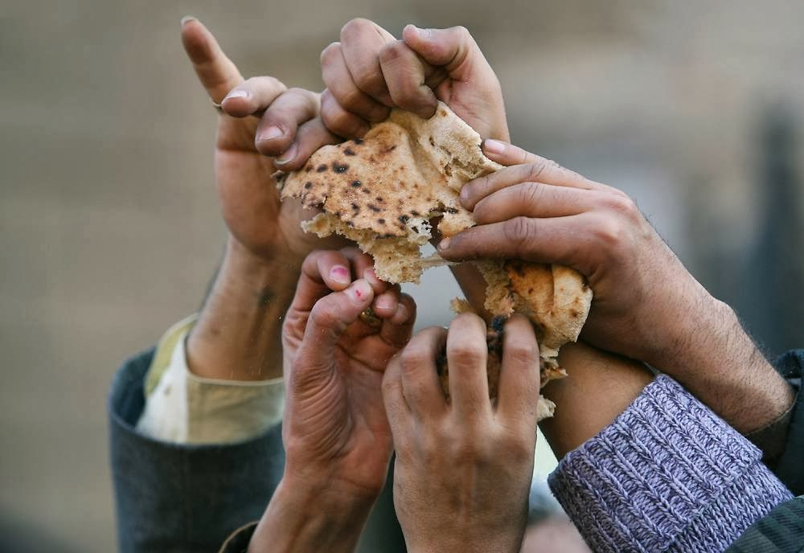
1. inviting ‘breaking of bread networks’ in own communities 2. a pastoral act for all disciples to all be involved in 3. small missional communities around ‘breaking bread’
SIMPLE AND TRANSFERABLE

Slide 15
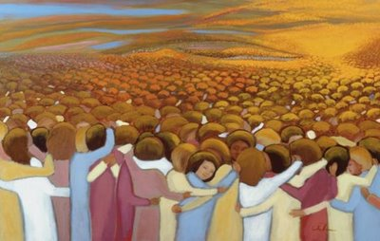
Sacramental 1. the visible SIGN OF AN Invisible God; a sacred symbol of God’s life giving love ‘We become what we share, and what we share represents what we are, a blessed, broken, thankful and shared people’

Slide 17
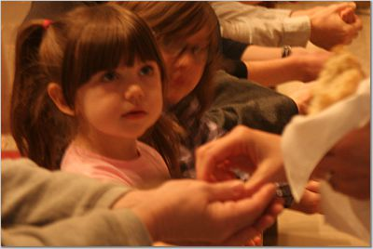
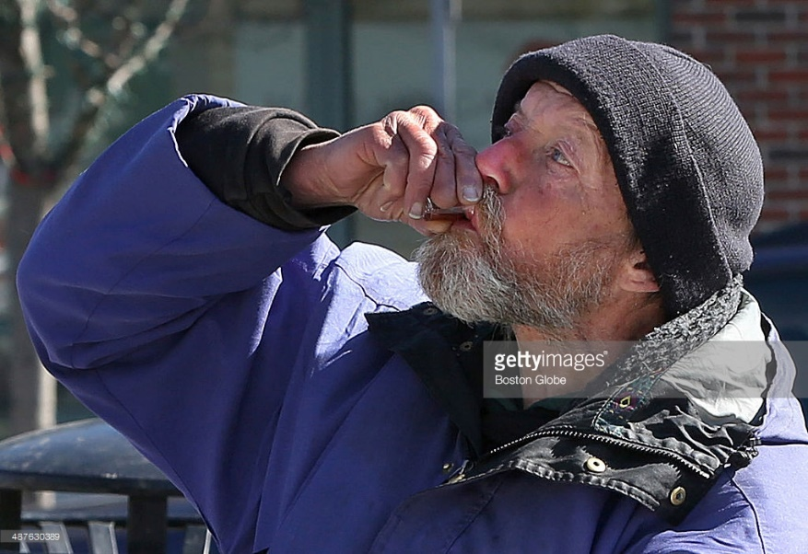
Pastorally ‘breaking bread’ serves many purposes deepens devotions nourishes the soul renews transforms refreshes heals humbles unites

Slide 18
Questions for consideration 1. why have we made something Jesus deliberately made so simple and so transferable, so complicated? 2. Could we celebrate the breaking of bread outside by the roadside, or park, or somewhere else in BeaconHill? 3. how can we be truly inclusive in breaking bread? 4. How is bread broken in other areas of the world?

Slide 19
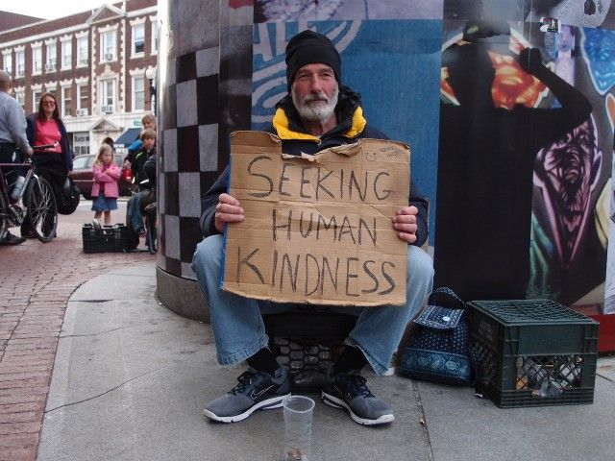

Slide 20
Hymn…Spirit of God, thou art in the bread of heaven prayers of intercession Hymn RS 582 thanks be to God, whose church on earth Closing prayer and blessing

