Slide 1
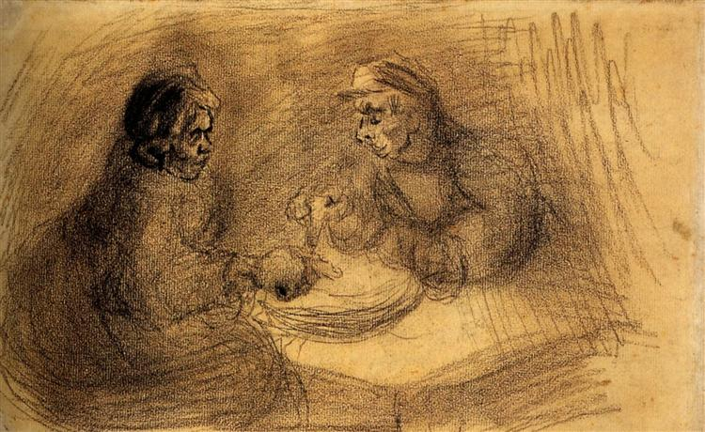
Theme – Holy Habits 7. Eating together

Slide 2
Call to worship Leader Guided by your Spirit, we have made the journey through the wilderness and desert, trekking across rocky paths and dirt tracks, and crowded city streets.

Slide 3
All We have travelled alone. We have travelled with those we love. We have jostled with those whose company we have not always enjoyed. But we have made it into your house, for rest, for inspiration, for forgiveness, for hope, for love.

Slide 4
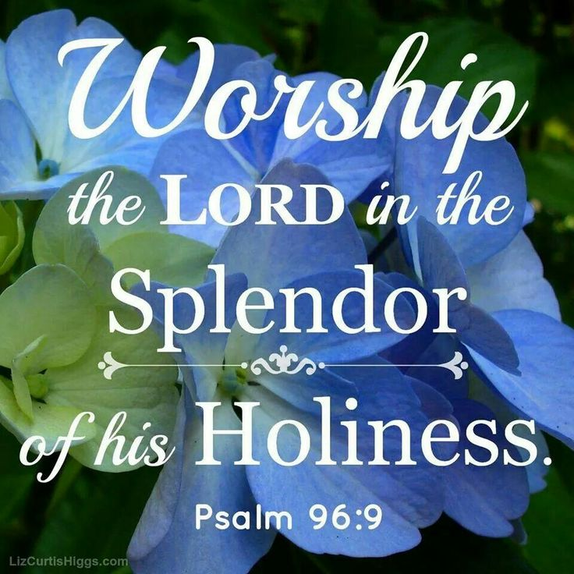
Leader Receive us afresh, renew us and inspire us, Lord. Amen.

Slide 5
Hymn RS 480 The church is like a table Prayers of Adoration, confession and Lord’s Prayer Reading Acts 2:37-47 Holy habit Fasting and feasting

Slide 7
Fasting
Fasting is an ancient faith practice.
Jesus himself practised it.
Not so much abstaining from food, but feasting on the word of God; so fasting is feasting.
Fasting develops personal holiness.
Helps us remember those who have no food.

Slide 8
Feasting
The value of living ‘rhythmically’ is both formative and missional.
Gathering gather monthly or weekly to share food and faith.
‘Tabletalk’, where during the meal a topic would be teased out and reflected upon.
Eating together encourages praying together, mediating on scripture together, and discussing missional ideas and activities together.

Slide 9
Hymn When we come to eat together Reading Luke 14:15-23 Holy Habit Table Fellowship

Slide 10
Table Fellowship
Luke - 60 references to food and drink and 10 occasions
in which Jesus is seen sharing a meal
Reminds us of the corporate nature of discipleship
Important in the early church, and allowed the early Christians a pattern of table fellowship found in the Gospels
The atmosphere of shared meals was one of gladness

Slide 11
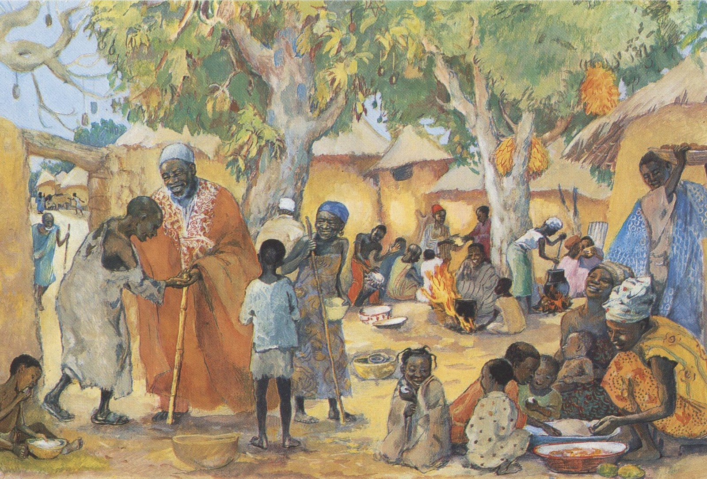
Biblical image of ‘a heavenly banquet’

Slide 12
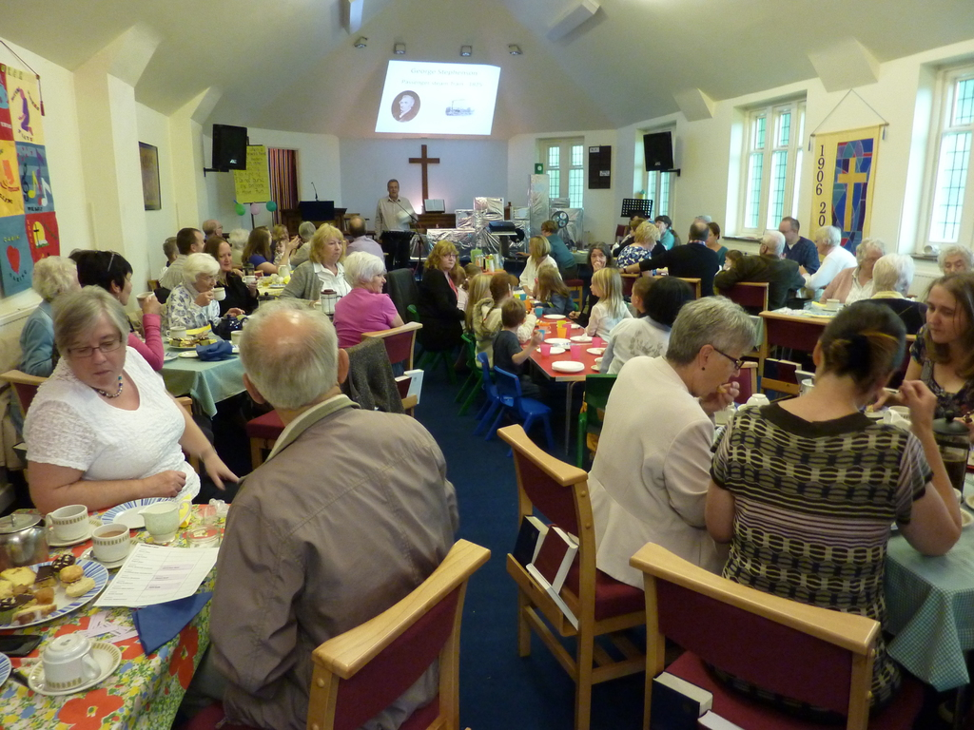
Fresh expressions of church, including eating together

Slide 13
Multi-dimensional blessing
Eating together provides a space for other holy habits to be practised
It is a Christ like act in itself
Eating together creates Holy moments
Sharing a meal is a foretaste of God’s kingdom

Slide 15
Hymn It makes a banquet from a meal Offertory Prayers of Intercession Hymn RS 567 Thy hand O God has guided Closing prayer and blessing

