Slide 1
Holy Habit 10. Making more disciples

Slide 2
Call to worship words from Psalm 95 Leader Come and worship the Lord Jesus, King of kings, yet servant of all. All Come with your dreams, your longings, your hopes, and all those on your hearts today, to seek blessing and healing. Amen.

Slide 3
Hymn RS 285 O for a thousand tongues to sing Prayers of Adoration, confession and Lord’s Prayer Reading Acts 2:37-47 Matthew 28:16-20

Slide 4
Holy Habit … Making more disciples Think about the times when you have experienced a ‘light bulb’ moment, or an ‘epiphany’ about your faith? How did you respond?

Slide 5
What is Evangelism?
To understand the full meaning of evangelism, we need to return to the Greek word ‘sozo’ to heal, to save, to be made whole.
Biblically being saved is much more than getting our cards stamped for heaven. It is about being whole, being reconciled with God, reconciled with others, reconciling with creation and being reconciled with yourself.

Slide 6
The process of Evangelism? 1. Evangelism is preaching or communicating the gospel values and putting our discipleship into action 2. Learning is not just a cerebral activity, it is an emotional activity as well 3. Discipleship is caught as well as taught

Slide 7
Hymn Jesus Christ is waiting Offertory

Slide 9
Bless, belong and believe Emphasis on the place of blessing in living out the commission to make disciples. Gives a sense of belonging Through blessing and belonging, belief will emerge

Slide 10
Markers and milestones For all who follow Jesus on the adventure of discipleship there will be significant moments. The start of discipleship is marked with two markers, Baptism with water Baptism of the Spirit

Slide 11
An expectation of growth Through conversations and Gossiping the Gospel, the seed of faith will be laid. That means all disciples have a responsibility to make disciples, but we may never see the fruits of our harvest, that is for other people to reap.

Slide 12
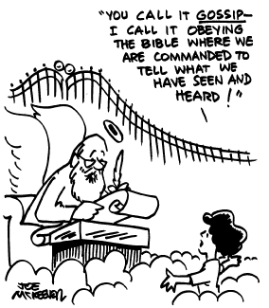
Do we Gossip the Gospel? Growth has been seen where churches have supported particular projects or campaigns about injustice and inequality.

Slide 13
Divine commission The Greek verb matheteuo (make disciples) occurs three times in the NT. In the NT there is divinely infused passion, urgency, energy and fruitfulness about the Holy Habit of making disciples. There is a spirt filled excitement.

Slide 14
Questions for consideration.
Do we / you have a Spirit-filled passion to evangelise?
What are the fears of evangelising ?

Slide 15
Hymn RS 580 Lord you give the great commission Prayers of Intercession Hymn Christ is alive! Let Christians sing.

