Slide 1
Theme – Holy Habits 4. Prayer

Slide 2
Call to worship ♫ Bless the Lord, Bless the Lord, Bless the Lord, there is no other God (Repeat x 3) Hymn 302 O breath of life come sweeping through us opening prayers and the Lords Prayer song before the reading Reading Luke 11: 1-13

Slide 3
1. Biblical teaching 6. Service
2. Fellowship 7. Eating together
3. Breaking of bread 8. Gladness and generosity
4. Prayer 9. Worship
5. Giving 10. Making more disciples

Slide 4
‘Lets Pray !’ Let’s pray … WHAT COMES TO Mind?

Slide 5
The breath of Life , the breath of God 1. YHWH, can be pronounced without our tongue for vocal chords, but by our breathing in and out 2. One of the Greek words for Spirit is ‘Pneuma’ which means ‘air’ or ‘breath’ 3. True prayer is more than bowing our heads; 3. prayer is the spiritual air we breathe

Slide 6
5. We breathe in God’s grace, blessings, love, courage and holiness of God, and breathe out adoration, confession, prayers for others / intercession. 6. We encounter mystery and silence 7. When we run out of words the Spirit breathes in and out and ‘prays through our groans and sighs’

Slide 7
Prayer can be anytime, anywhere, Private and public , it can be wordy, symbolic or in stillness But ultimately, Prayer is when we are in Communion with God

Slide 8
Video Richard Rohr- Prayer

Slide 9
Hymn rs 495 Father hear the prayer we offer offertory reading Acts 2:37-47 Fourth holy habit … Prayer

Slide 10
Who we are…is How we pray Prayer should reflect our personality enneagram Types; feelers, doers, observers

Slide 11
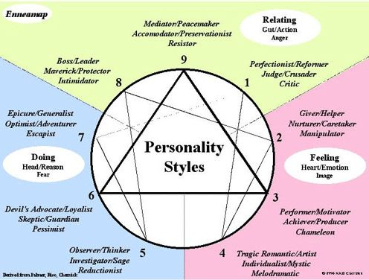

Slide 12
God centred Prayer … ACTS Adoration Confession Thanksgiving Supplication

Slide 13
Refreshing prayer 1. Of all of the Holy Habits, prayer is the one that can often become dry and barren. 2. We could be tired physical or emotionally, but God is always waiting to be in communion with us. 3. We always need to refresh our prayer, by adapting it and modifying it.

Slide 14
Video Thy Kingdom come – prayer

Slide 15
Hymn Lay your Healing hand upon me Prayers of intercession Hymn RS 413 What friend we have in Jesus Closing prayer and blessing May God’s blessing surround you each day; as you trust Him and walk in His way; May his presence within, guard and keep you from sin; Go in peace, go in joy, go in love.

