Slide 1
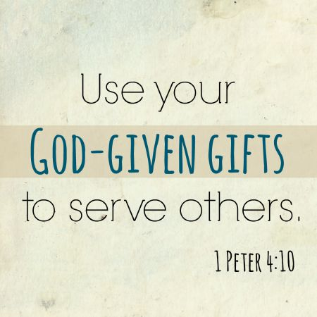
Theme - Holy Habits 6. Service

Slide 2
Call to worship Hymn RS 293 Ye Servants of God Prayers of Adoration, confession and Lord’s Prayer Reading Acts2 37-47 Matthew 25:31-46 Family address Are you being served ?

Slide 3
Are you being served ?
Mission is one of the key elements of serving.
It involves a relationship with another person or situation where we demonstrate God’s love in action.

Slide 4
It is through our mission that we are changed by our encounters with others for it is often in them that we meet the ‘otherness’ of God.
Yet as Christians we need to recognise the Living Christ in our service. So it is the presence of Jesus that forms us as disciples as we serve and engage in Gods mission.

Slide 6
Hymn Sometimes we hear your call to loving service Offertory Hymn RS 522 From Heaven you came helpless babe Holy Habit Service – God’s special concern for the poor

Slide 7
A dying church reborn …
Stoneycroft United Reformed Church ... a dying church asked the question
‘How could we serve you Lord
and the community’?

Slide 8
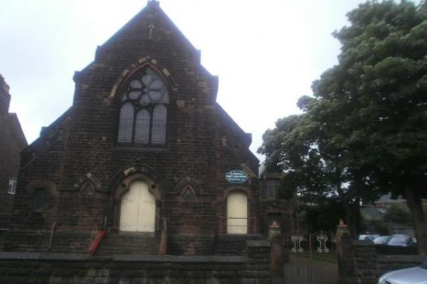

Slide 9
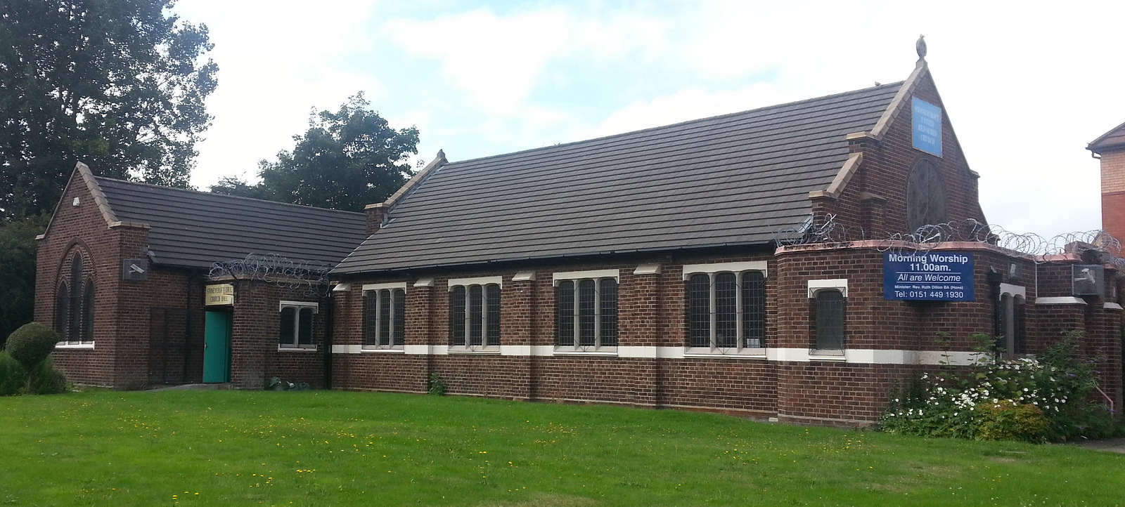

Slide 10
Incarnational Mission
The word became flesh and moved into the neighbourhood.
The danger of disconnection, means that we must always have a compassionate heart and desire to change and adapt to the circumstances around us.
‘Christ like hospitality’ is radical

Slide 11
Hymn RS 646 Help us accept each other Prayers of Intercession Response Compassionate God All Hear our prayer Hymn Longing for light we wait in darkness Closing prayer and blessing

