Slide 1
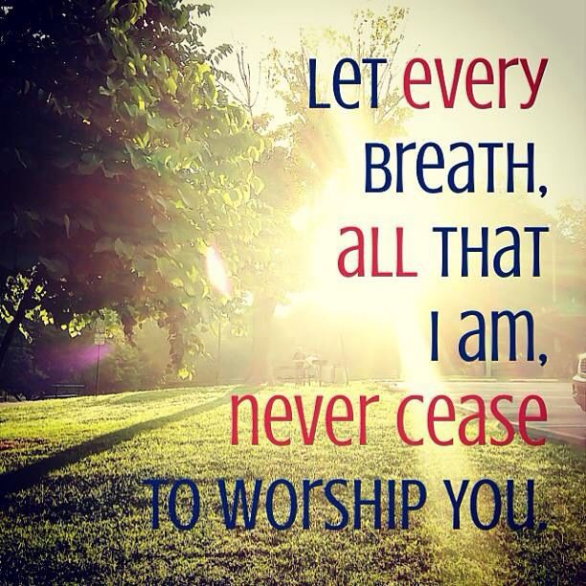
Holy Habit 9. Worship

Slide 2
Call to worship ‘Bless the Lord’ Hymn RS 118 Praise to the Living God Prayers of Adoration, confession and Lord’s Prayer Reading Deuteronomy 6:1-9 Holy habit WORSHIP

Slide 3
Worship

Slide 4
Worship as a way of life
Worship was at the heart of early Christian life.
Praising God at every opportunity
Worship is not just about gathering on a Sunday morning, it is much more than this; biblically worship is a way of life.
A way of life captured by the ‘Sheema prayer’
You shall love the Lord your God
with all your heart, and with all your soul,
and with all your might.

Slide 5
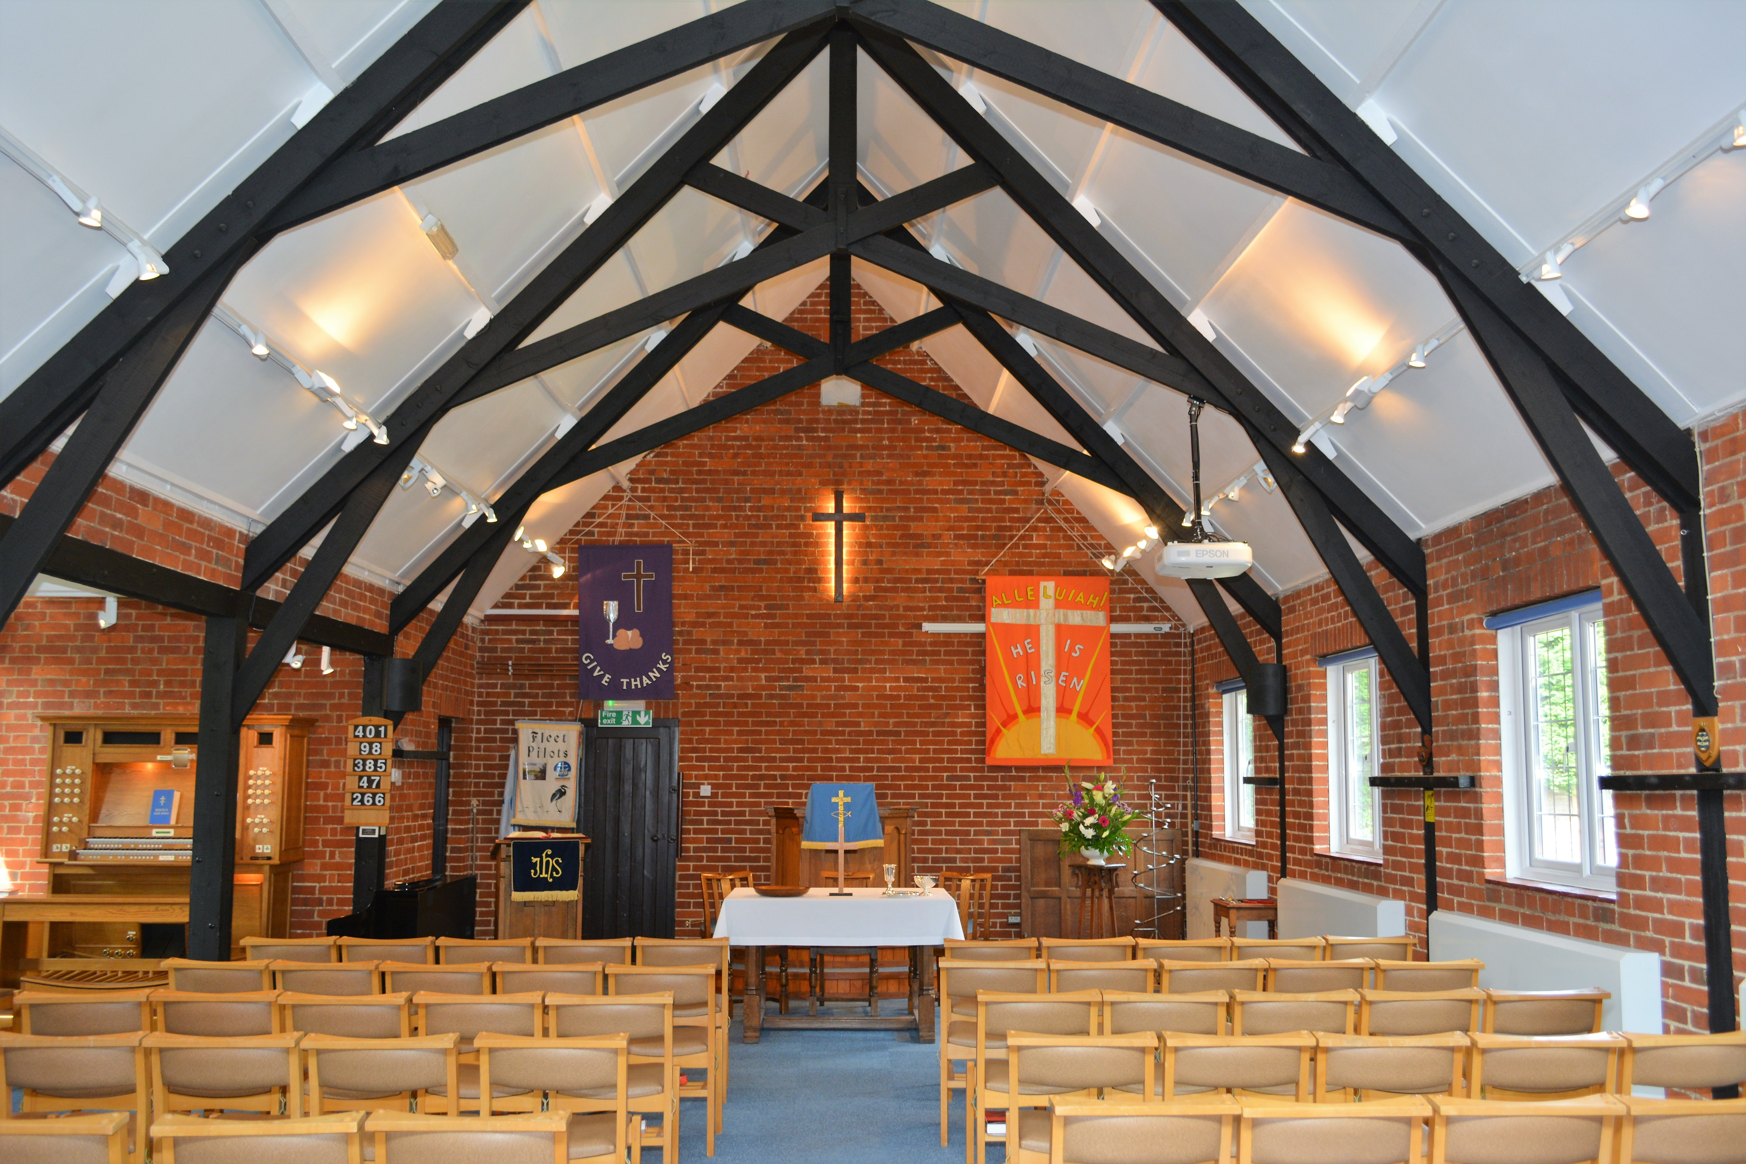
Worship is offered as thanks for all God does in our lives; our work, our rest, our enjoyment of creation, our service, our eating, our giving and yes our gathering together with fellow disciples for the focused activity of praise and worship.

Slide 6
Worship as devotion
There are number of different Greek words that are translated into English as ‘worship’, however the most common is proskyneo, which means ‘to come forward and kiss the back of the hand’. It is an intimate act, which denotes humility, reverence and devotion.
It also portrays the amazing grace of God

Slide 7
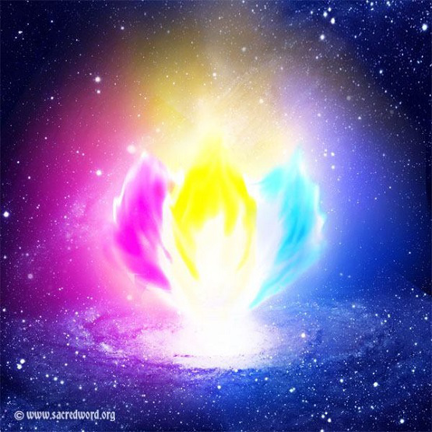
Worship as energy
Worship should be transforming
and
energising, depending on
which worship style is present

Slide 8
Hymn The true church is found where God’s purpose is sovereign Offertory Reading Luke 4:16-21 Holy Habit Rhythm and styles of worship

Slide 9
The Rhythm to worship
Being committed and lived rhythmically.
All gather together regardless of differences in theologies and personalities
Worship the first and foremost gift we offer to the divine community of the Holy Trinity. We do so in honour of the God who is Love.
Worship must never be used as a ‘drop in to see who the preacher is this week’, but must realise that worship is the response to our faith.

Slide 10
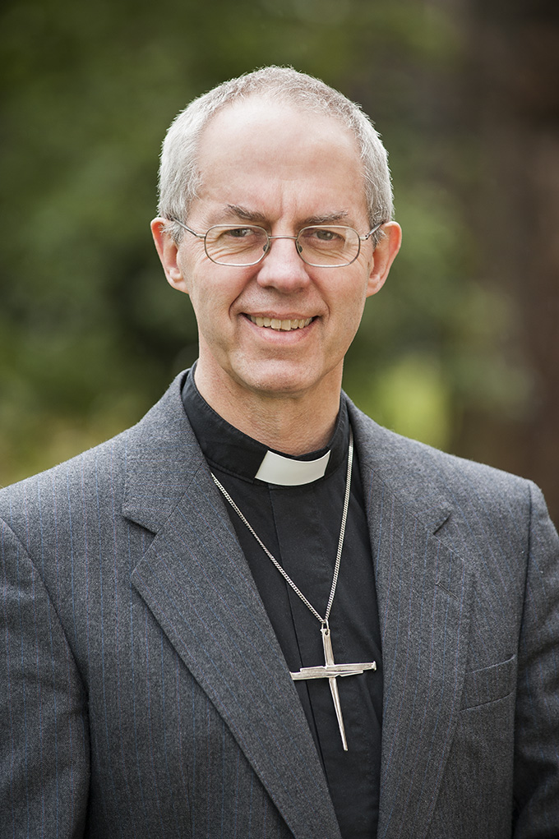
In 2015, Archbishop Justin Welby said this First, the church exits to worship God in Jesus Christ; Second, the church exits to make new disciples of Jesus Christ.

Slide 11
Worship styles
Who we are is how we worship
Creating worship is a complex task
ACTS A adoration
C confession
T thanksgiving
S supplication.
There are matters of culture, age and resources to be taken into account.
There are four spiritual styles in worship
WORD, EMOTION, SYMBOL and ACTION

Slide 12
Questions for consideration.
How can you refresh your daily pattern of worship?
What was the best and worst worship service you have attended and why?
Share your experience of worshipping
in a different culture.

Slide 13
Hymn RS 497 Give to me Lord a thankful heart Prayers of Intercession Hymn Singing we gladly worship the Lord together

Slide 14
Closing prayer and blessing
The peace of the earth be with you,
the peace of the oceans too;
the peace of the rivers be with you,
the peace of the oceans too.
Deep peace falling over you;
God’s peace growing in you.

